Slide 1
Sequence
Notes:
Learning Objective: I can use logical reasoning to explain how some simple algorithms work.

Slide 2
Algorithm
Sequence
Notes:
Introduce students to key vocabulary for this lesson:
Algorithm: An unambiguous procedure or precise step-by-step guide to solve a problem or achieve a particular objective.
Sequence: A sequence is when we arrange something in a particular order. Sequence-based algorithms are made from a precise set of instructions.

Slide 3
A sequence is when we arrange something in a particular order. Sequence-based algorithms are made from a precise set of instructions.
Notes:
Remind students about the importance of sequence in computing/coding.
In sequence-based algorithms, such as a recipe to bake a cake, the order of many (though not all) of the steps is crucial. Similarly, most programming languages are based on a series of statements to sequentially process. The outcome of a program will depend not only on the constituent commands but their order.

Slide 4
Notes:
Remind the students about the various types of sequence.
You may want to point out the brush your teeth sequence you made last week.

Slide 5
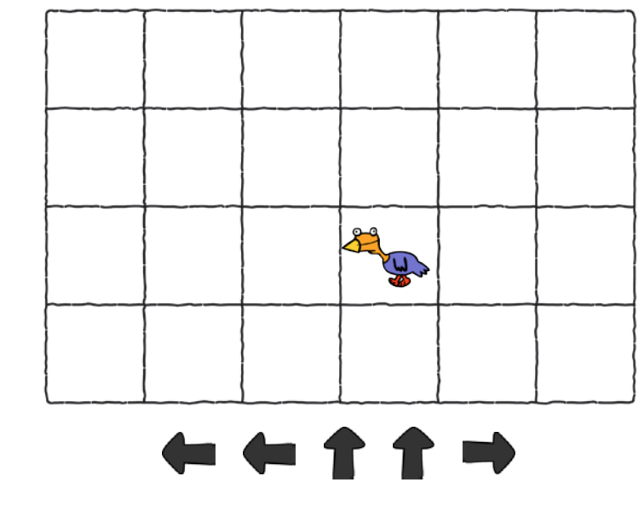
Notes:
Introduce your students to ‘Chicken’.
Explain that we are going to predict where Chicken (the spirit) we go by reading or tracing the directions/code on the map.
Where will chicken end up if it follows the instructions in the correct order?
Walk your students though this and then let them explore more examples on paper (you can find the PDFs for this in Busythings here: https://www.busythings.co.uk/lgfl-login/?activitytag=pdf_chicken_path

Slide 6
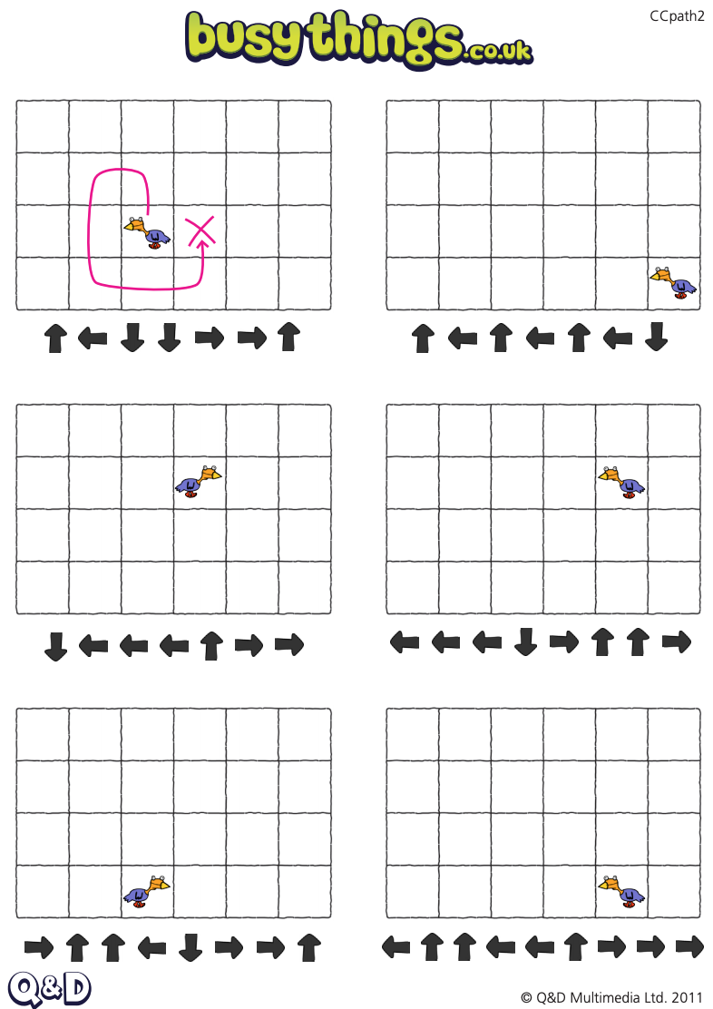
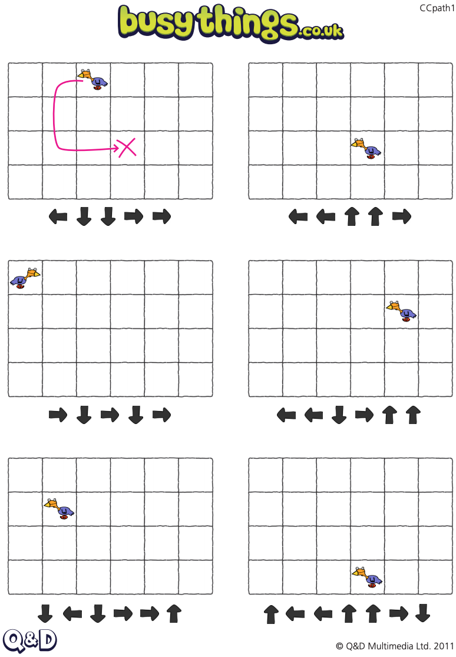
Notes:
You don’t need to get all of your student to do all of these, select 4/5 examples.
Make sure that you allow time for your students to read/trace the code, some students may want to get up and walk though the directions or they may want to use a counter to move around on the map.

Slide 7
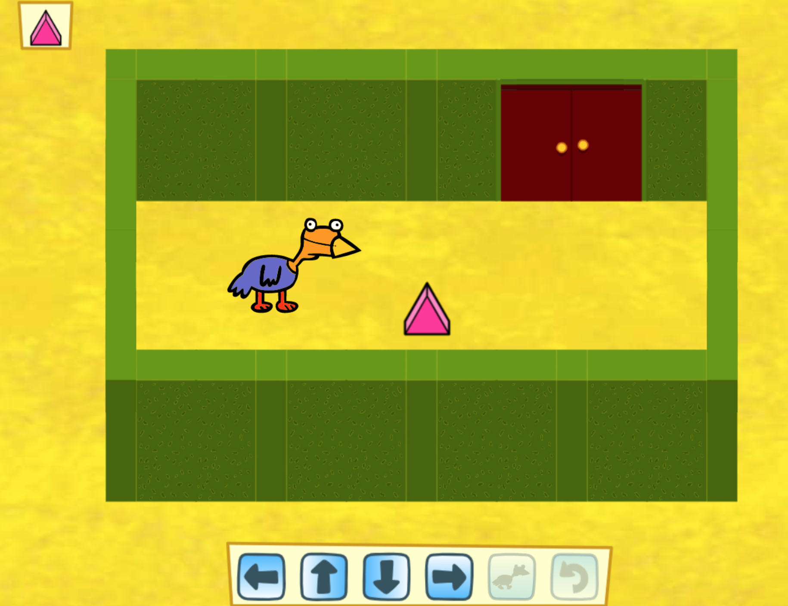
Notes:
Now allow your students to explore Path Peril https://www.busythings.co.uk/lgfl-login/?activitytag=chicken_path
Help the chicken to collect the shapes in the order displayed on the panel in the top left of the screen. Use the button panel at the bottom of the screen to program a path for the chicken to follow. If you are on a desktop computer, you can also use the arrow keys to plan the chicken's route and the spacebar to make him walk. The backspace key will undo the last path put down. Remember to watch out for the traps in later levels!

